Slide 1

Gilman Scholarship: Studying in Japan
Ian Caldwell

Slide 2
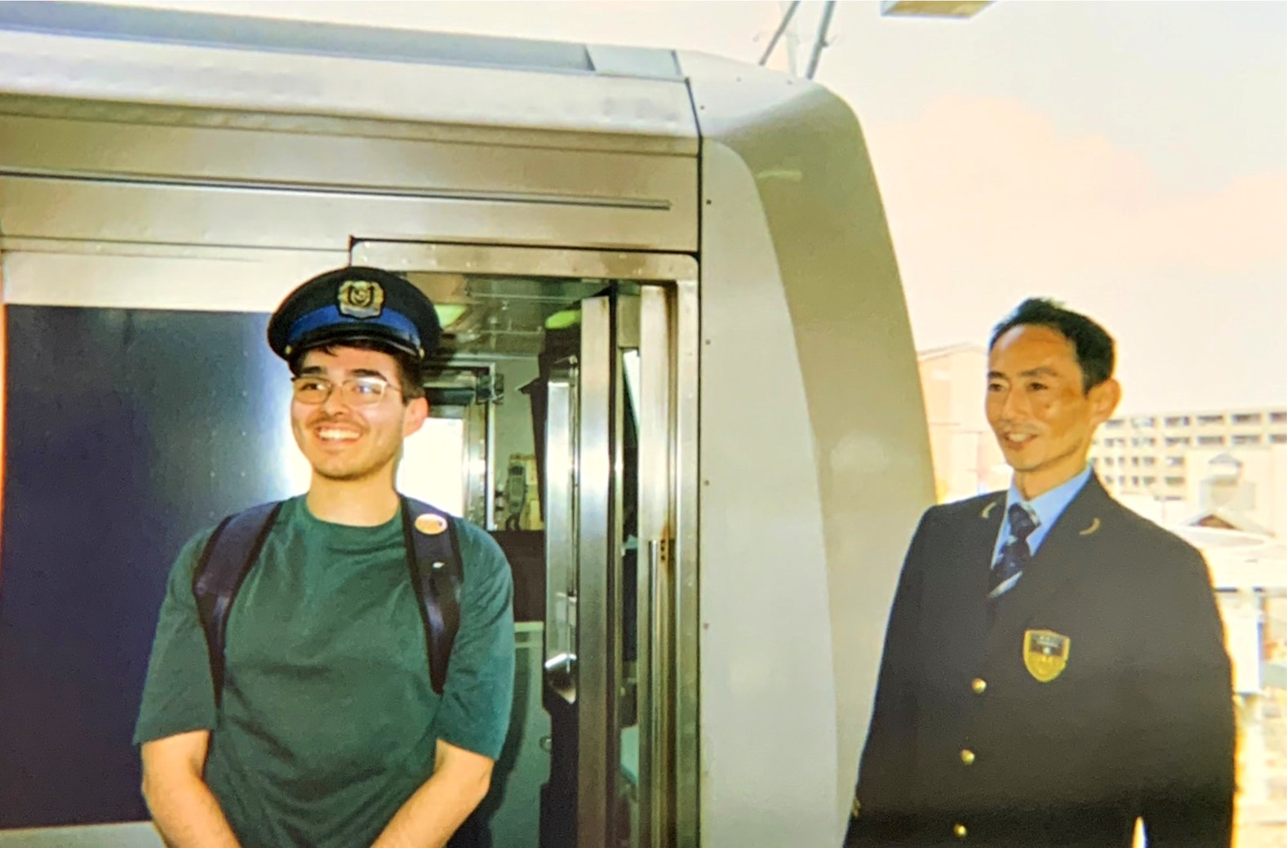
Introduction
“CS” student
Started learning Japanese in 2021
Born in San Antonio, raised in the RGV
Love public transportation infrastructure
2 younger sisters

Slide 3
Gilman Application: Crash Course

Slide 4
Eligibility
Pell grant Recipient
NO MINIMUM GPA OR PROGRAM LENGTH!!!
US Citizen
Proof of Program Acceptance
Good utsa standing
Countries with low travel advisories

Slide 5
3 Essays
Statement of purpose
Building mutual understand
Follow-on service project
7,000 characters (including spaces)
How will studying or interning abroad help you achieve your future academic or professional goals?
What can you draw on to meet the challenges of going abroad?
3,000 characters (including spaces)
As a U.S. citizen, how will you represent and share what it means to be an American during your program?
3,000 characters (including spaces)
What is your project and how will it increase awareness of study abroad and the Gilman Program
How will you integrate the impact of your experience abroad into your project?
Ex: K-12 outreach, campus outreach, study abroad mentor

Slide 6
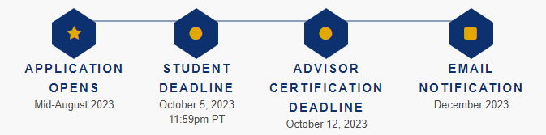
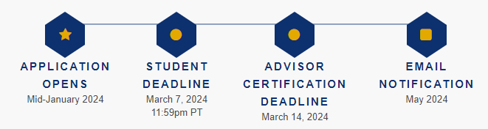
Application Timeline
Fall 2023: October 5, 2023
Spring 2024: March 7, 2024

Slide 7





Strong Applicant
Never gone abroad before
diversity
Veteran
Stem
1st gen

Slide 8
Gilman Impact
UTSA:
Record 27 recipients last year
Total: $102,500
70% minority students
50% 1st gen

Slide 9
Gilman-McCain Award
deploy strategic networks with compelling e-business needs
PLANNING
synergize scalable e-commerce
MARKETING
disseminate standardized metrics
DESIGN
coordinate e-business applications
foster holistically superior methodologies
LAUNCH
STRATEGY

Slide 10
Gilman+
Up to $5,000
Critical Need Language Award- up to $3,000
STEM Supplemental Award- up to $1,000 (research)

Slide 11
My experiences in Japan: 1st Times

Slide 12


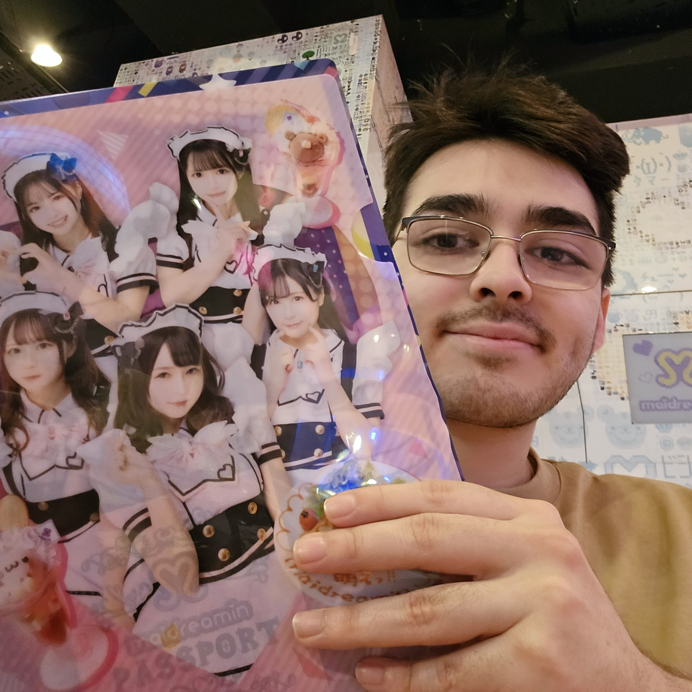
Culture

Slide 13
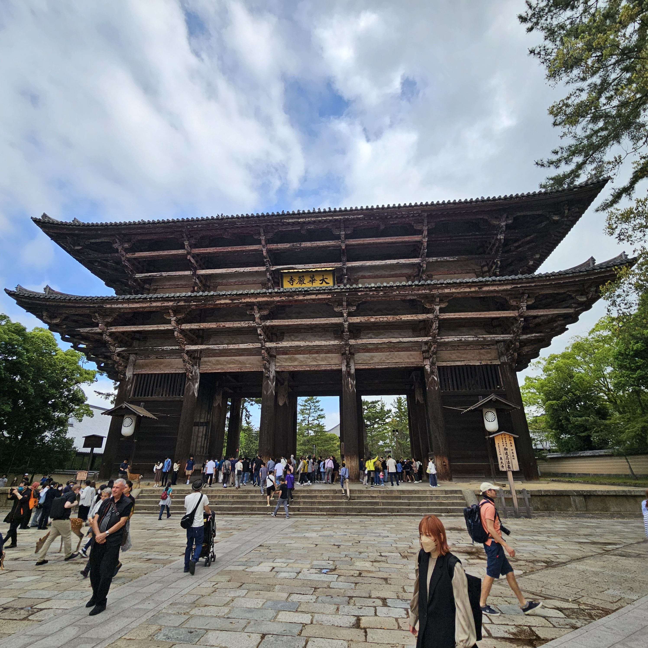

Slide 14

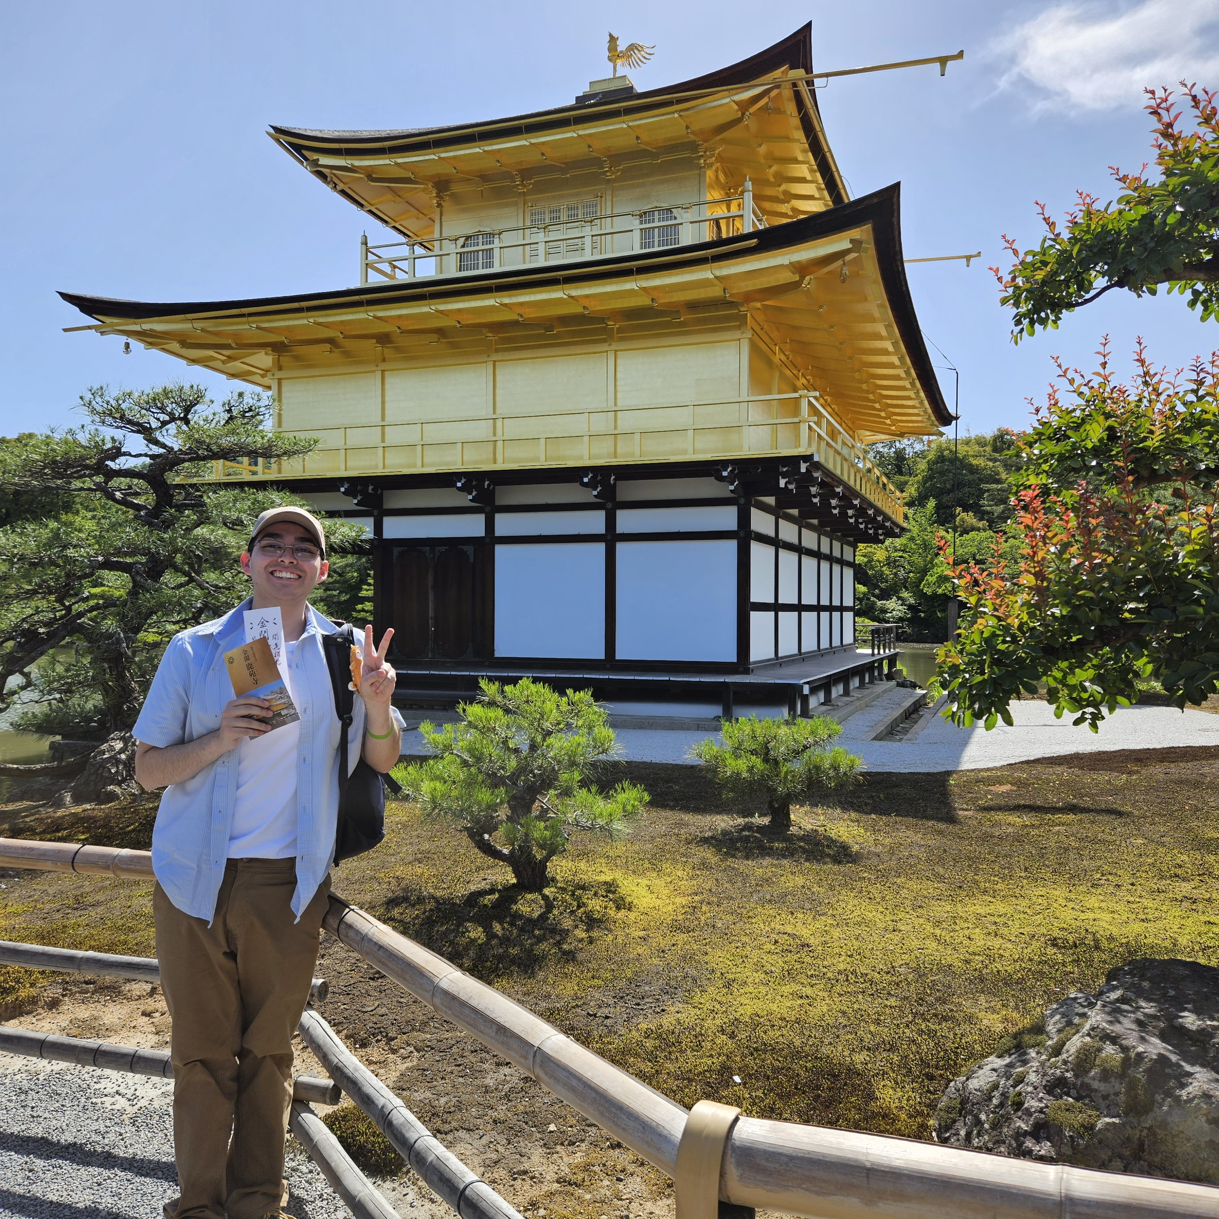

Slide 15
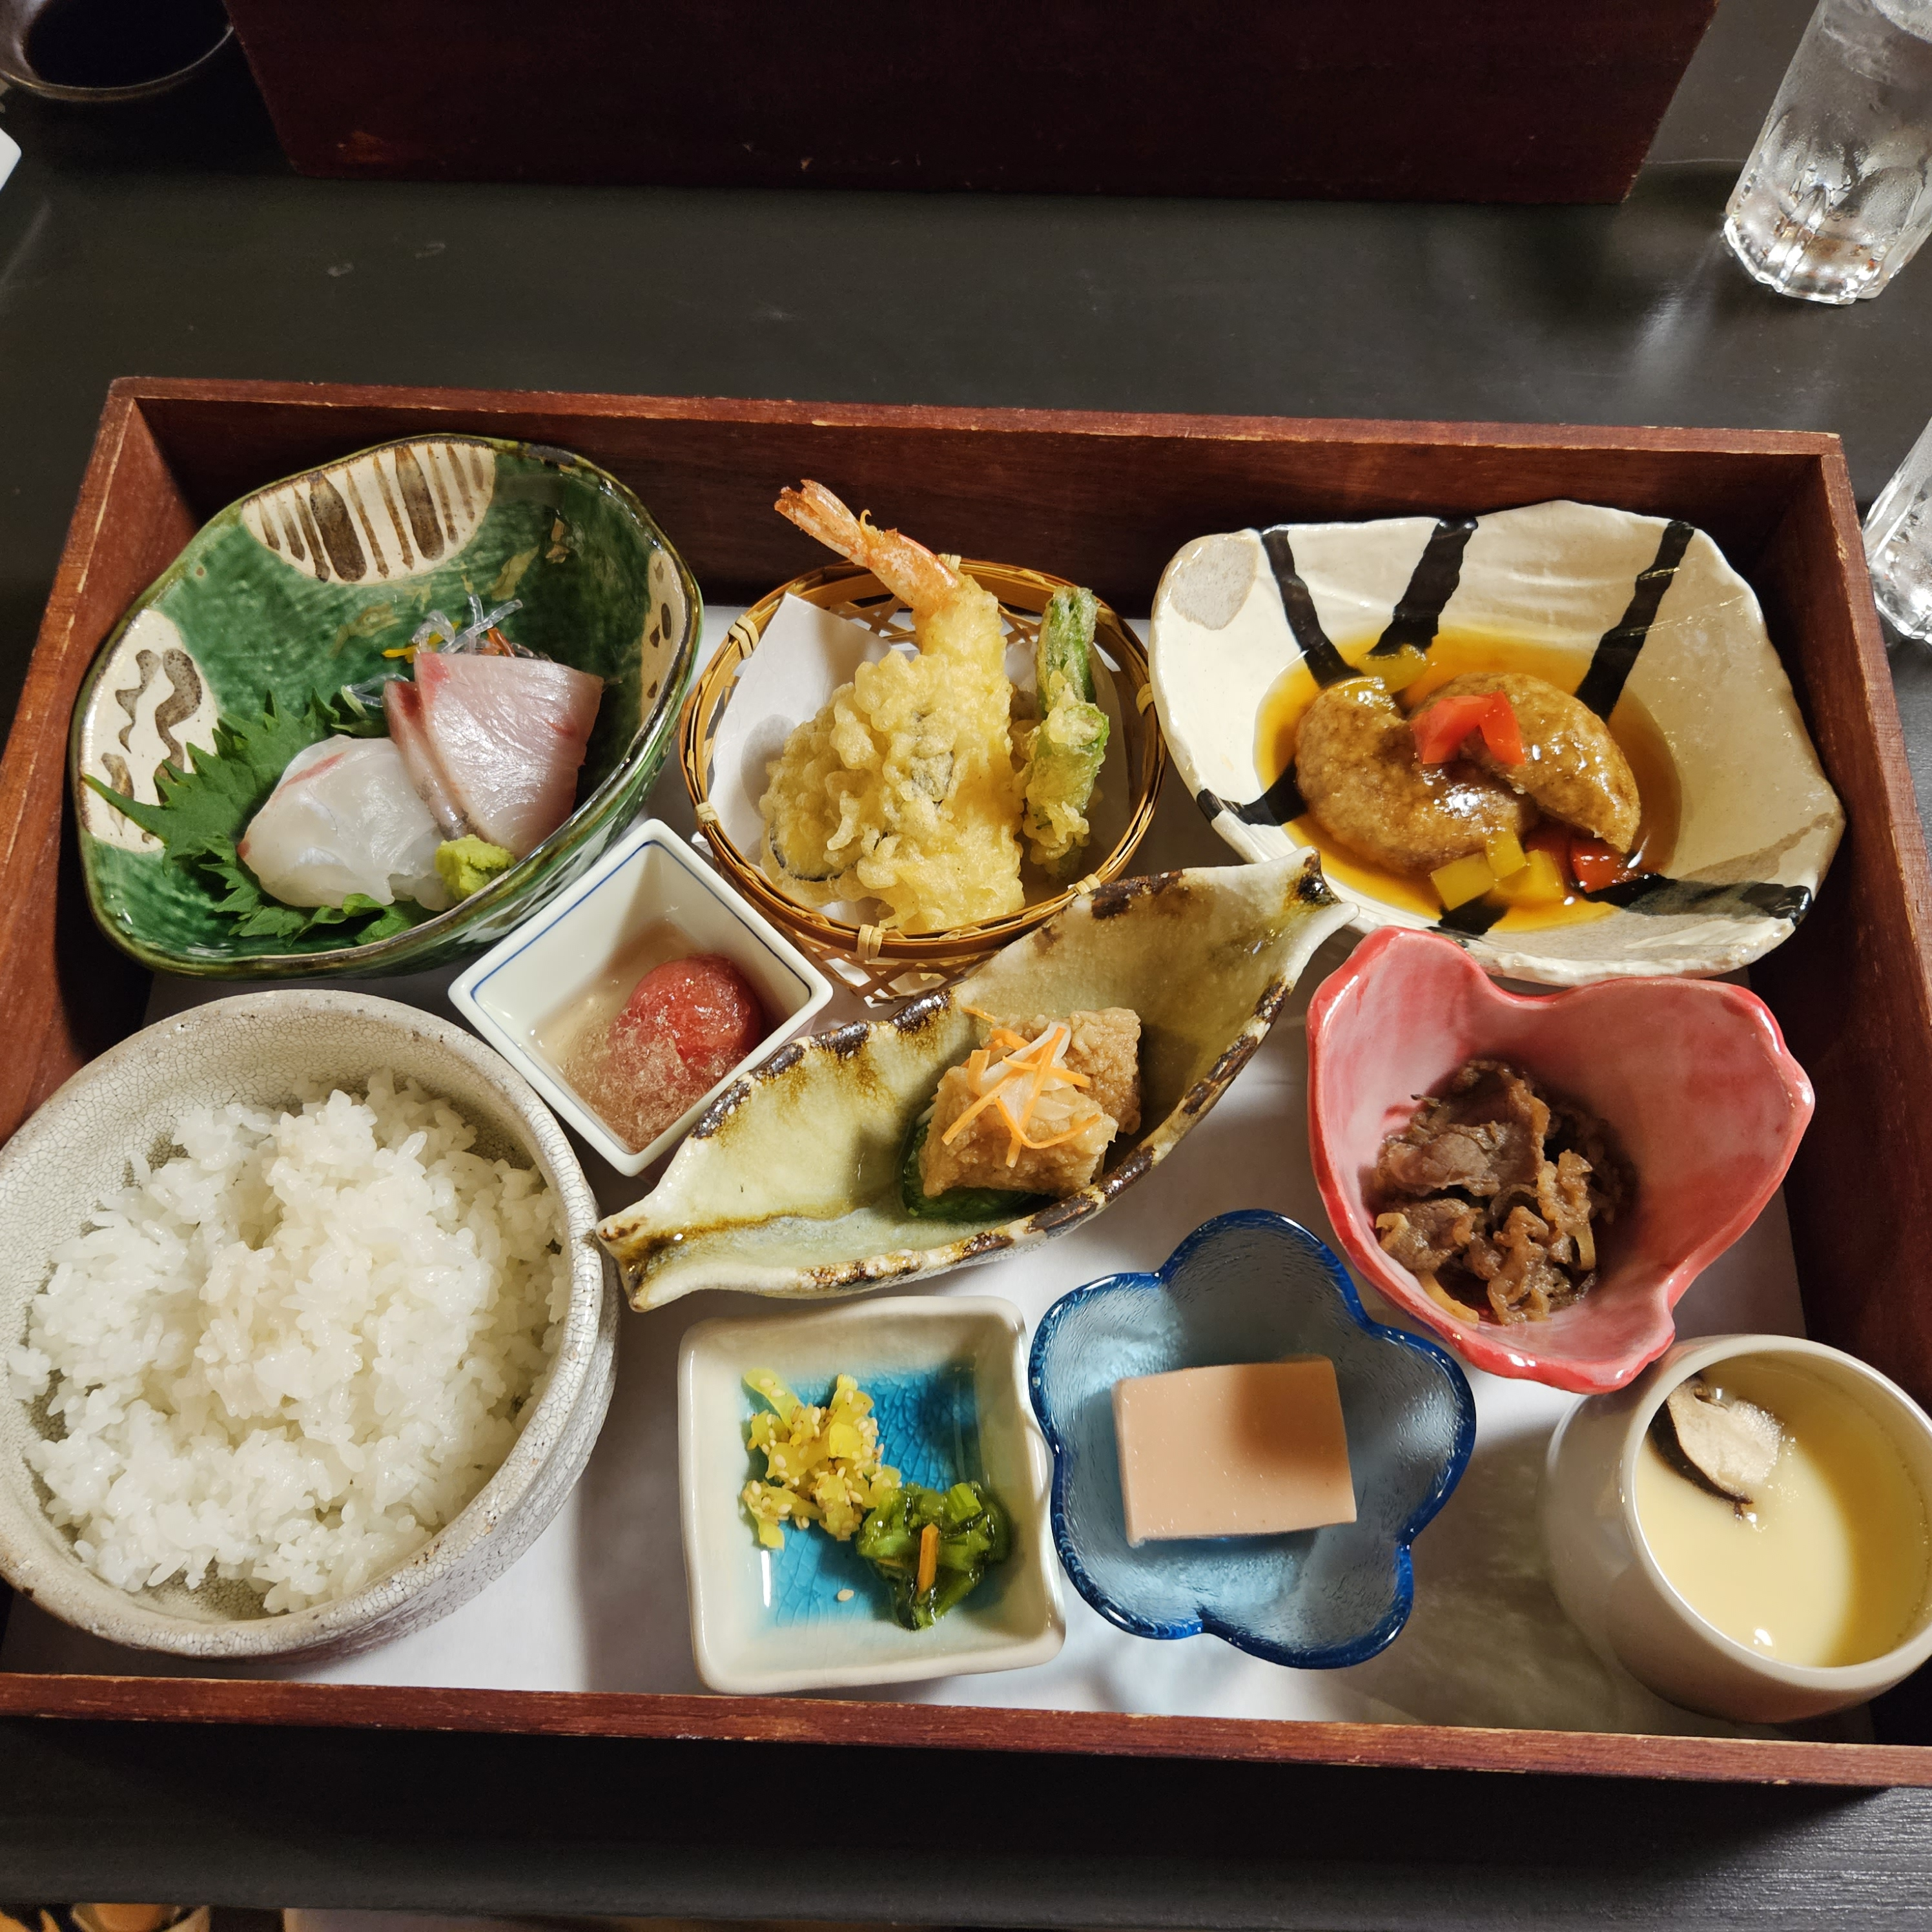
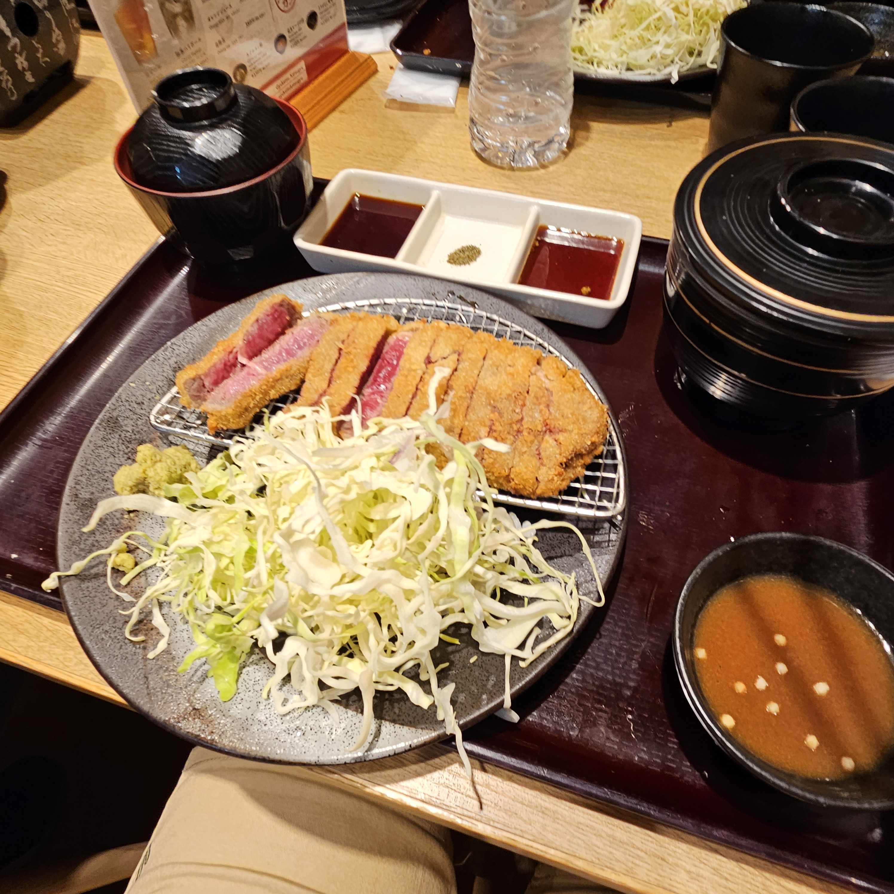
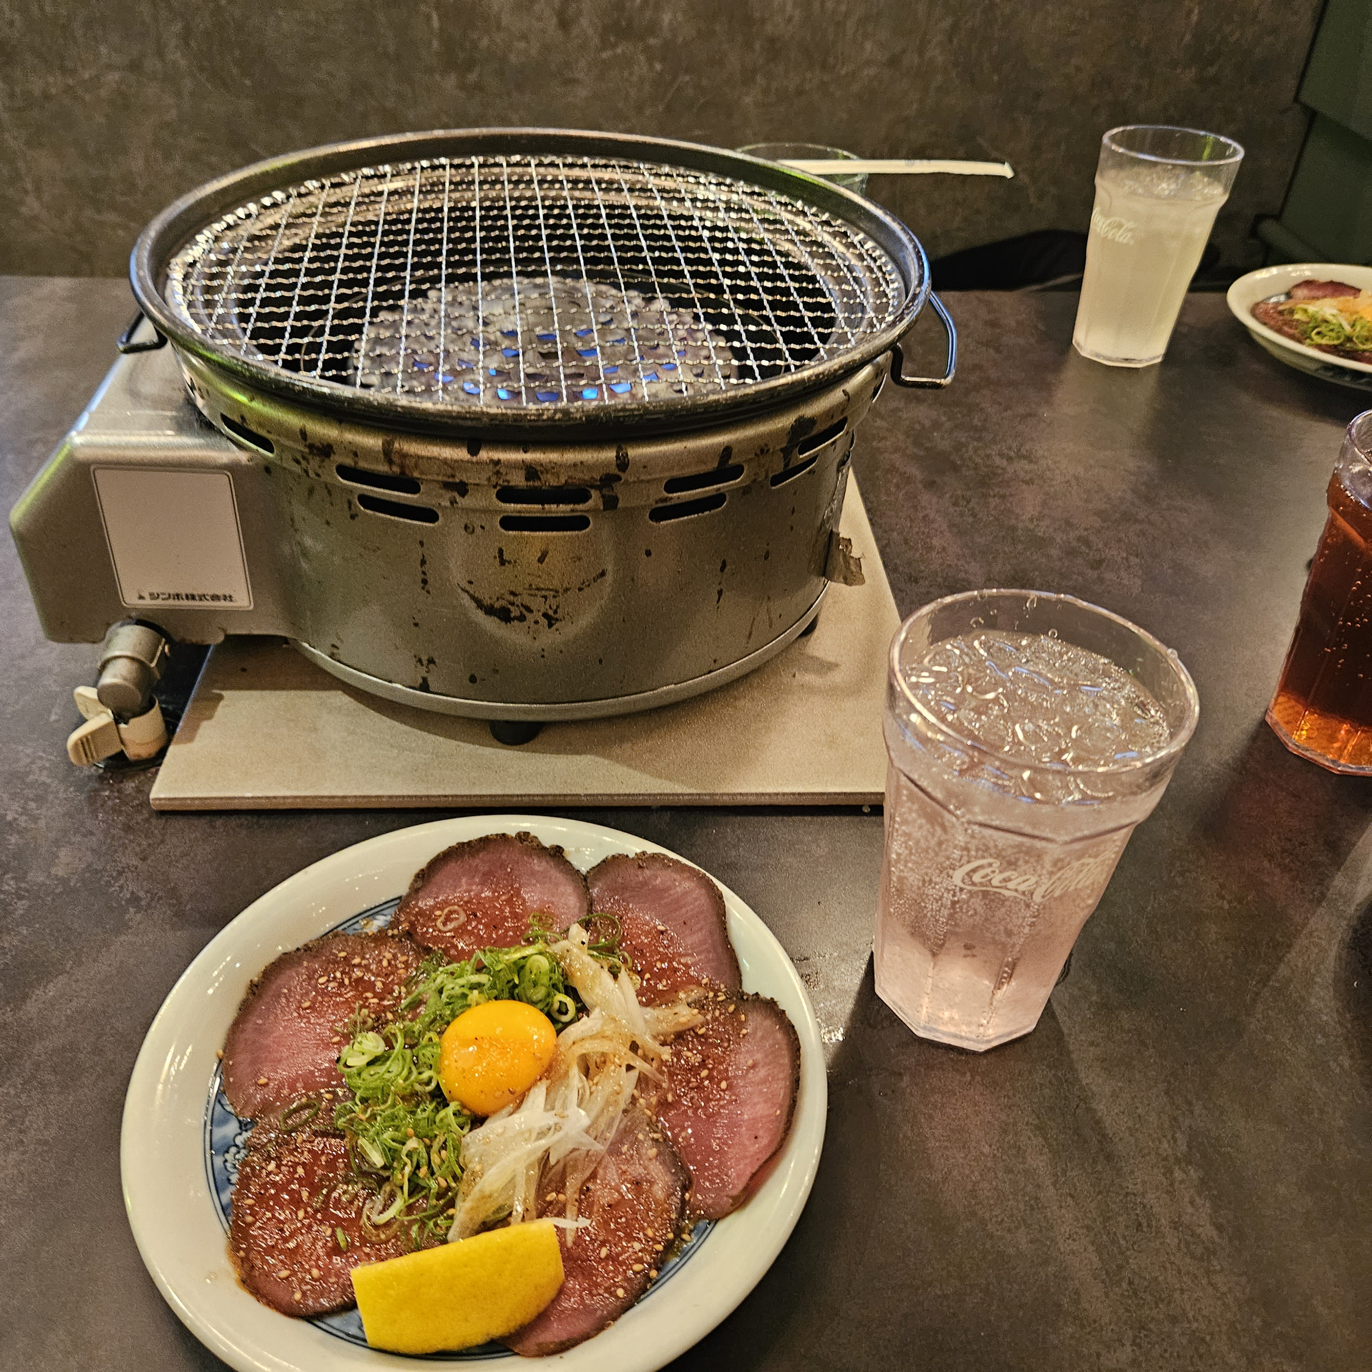
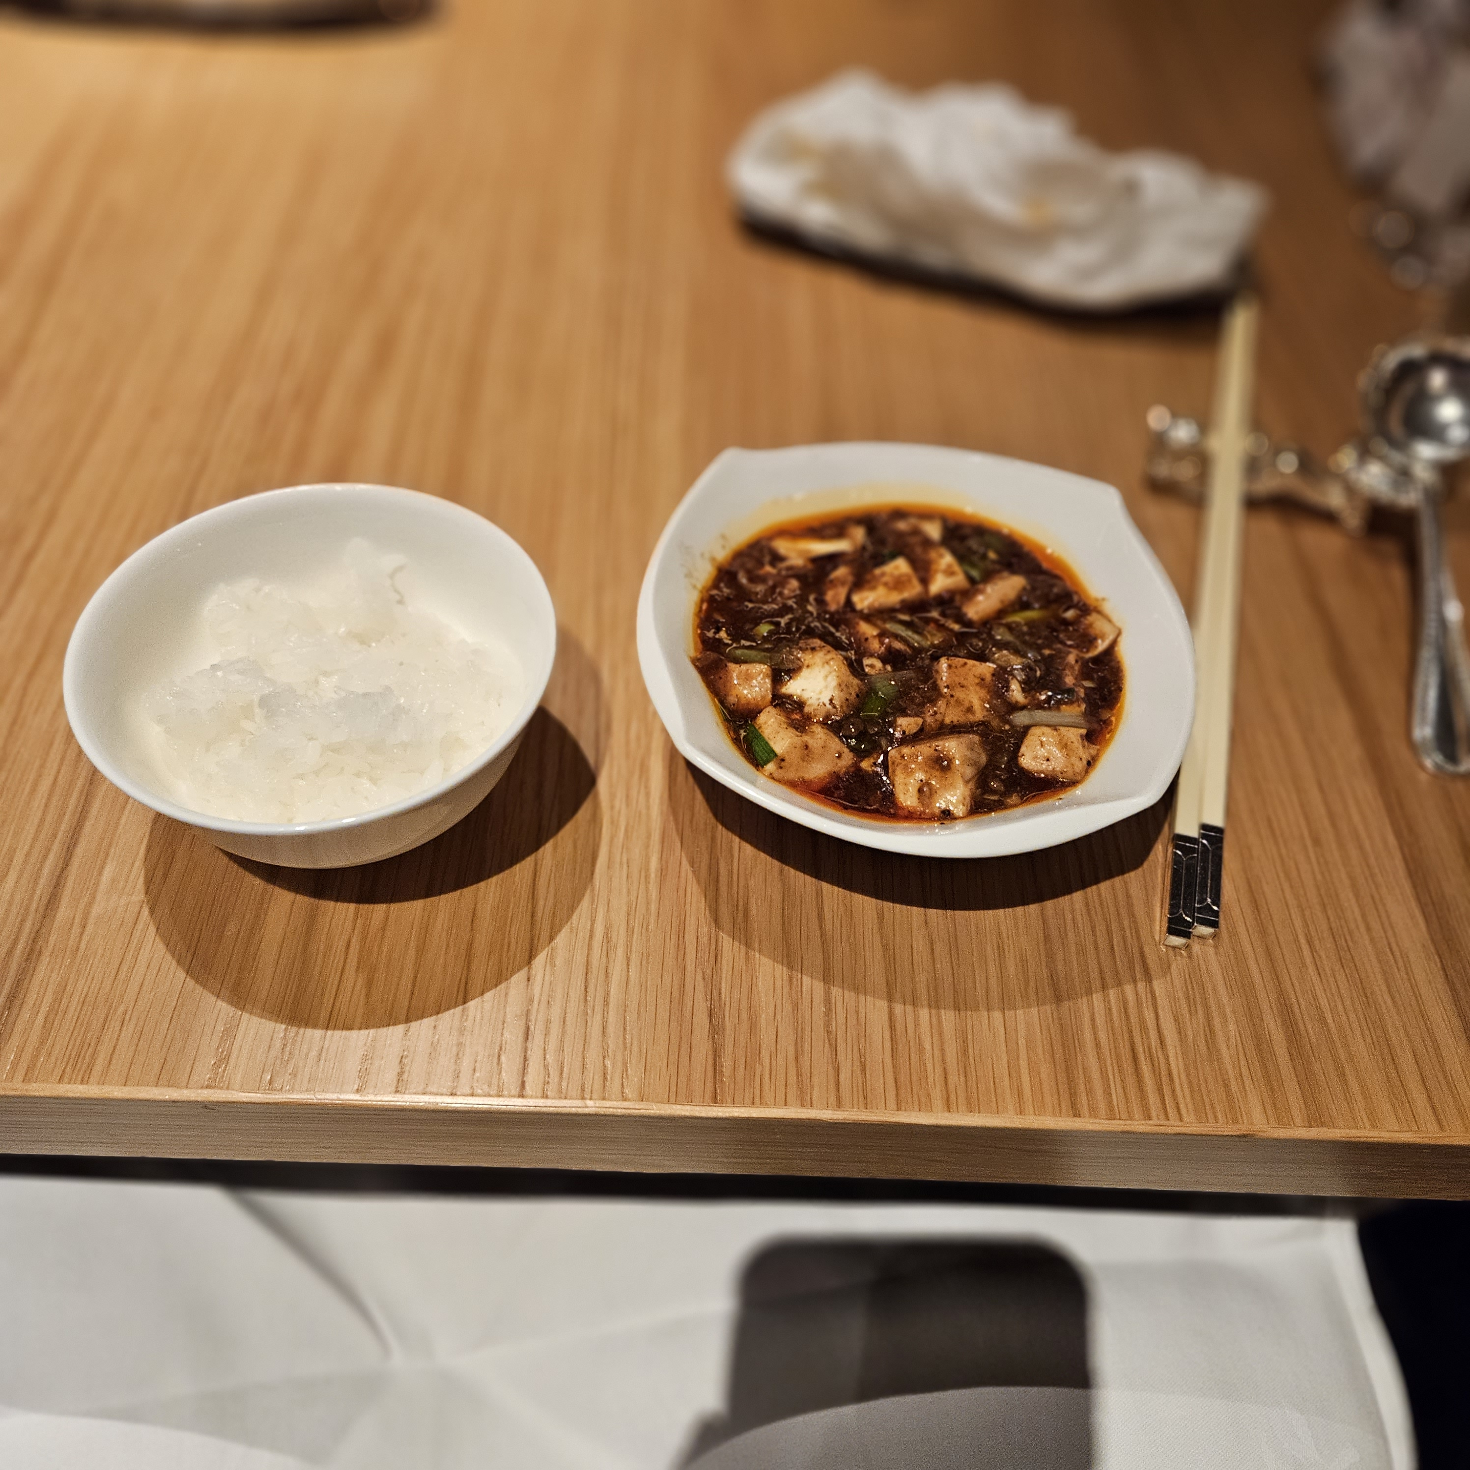
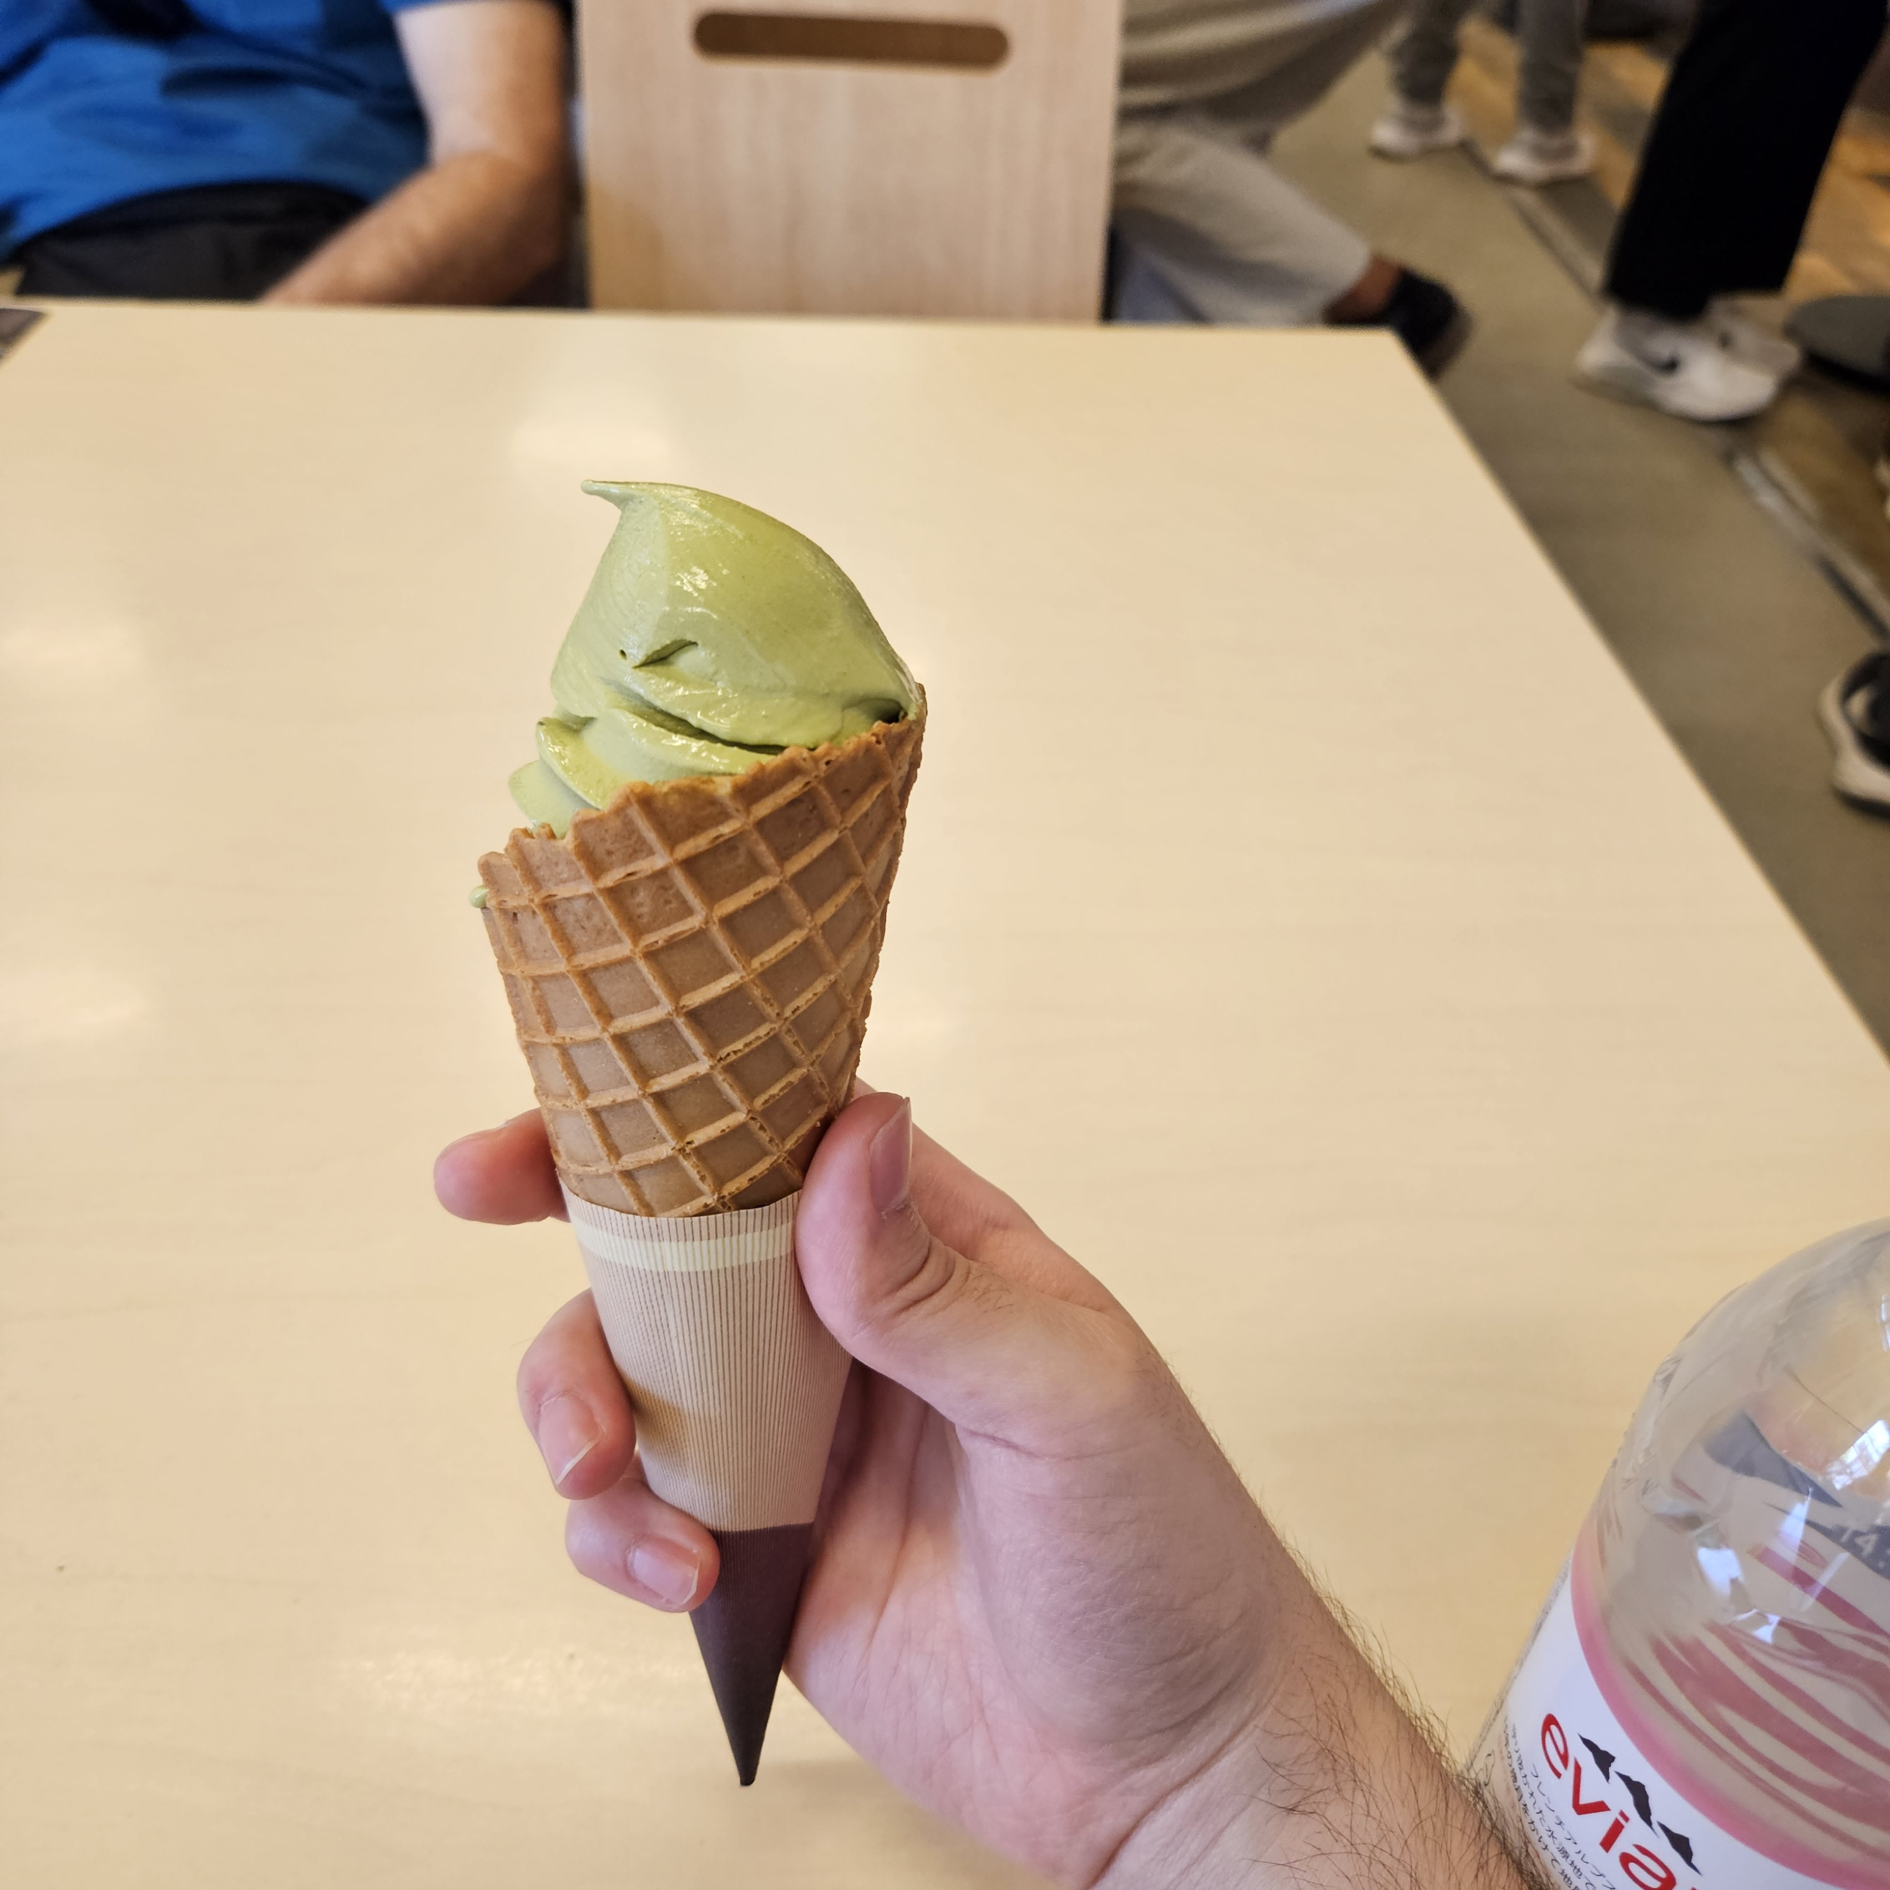

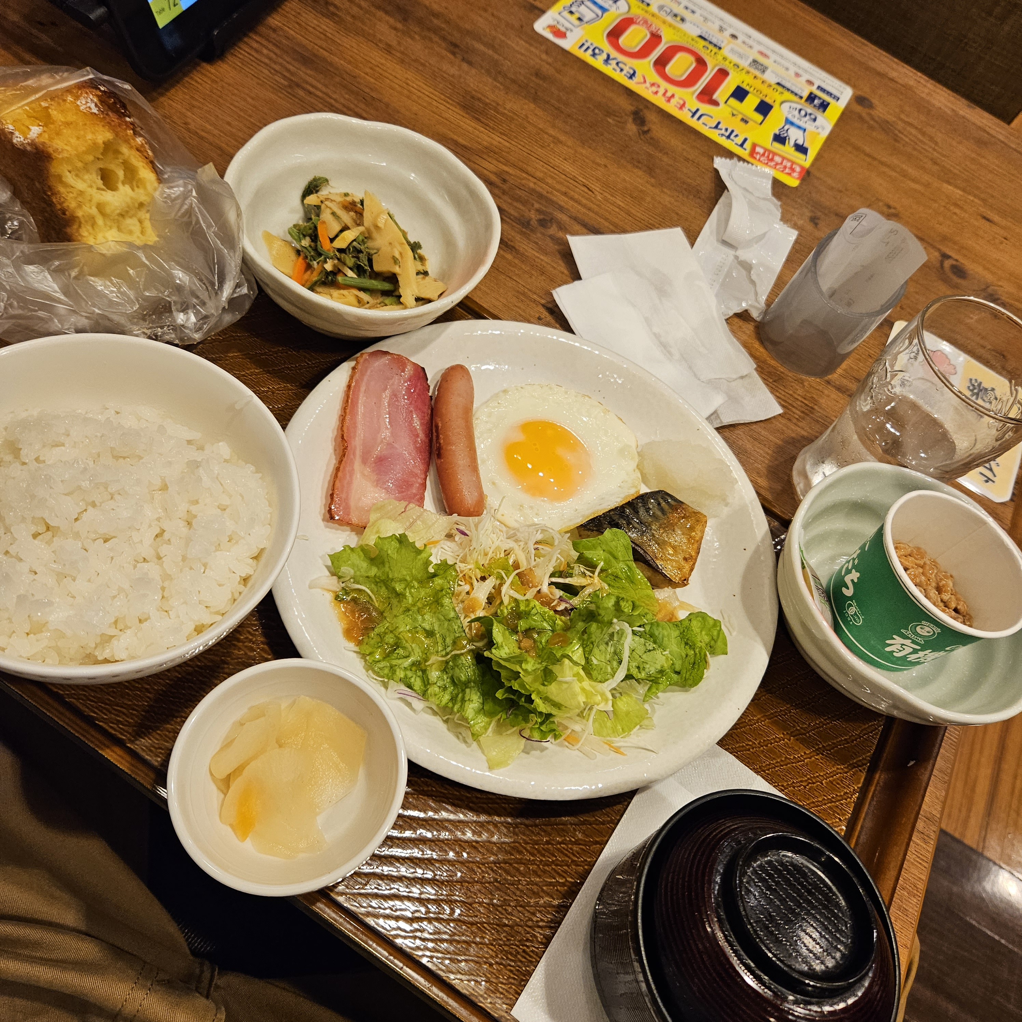
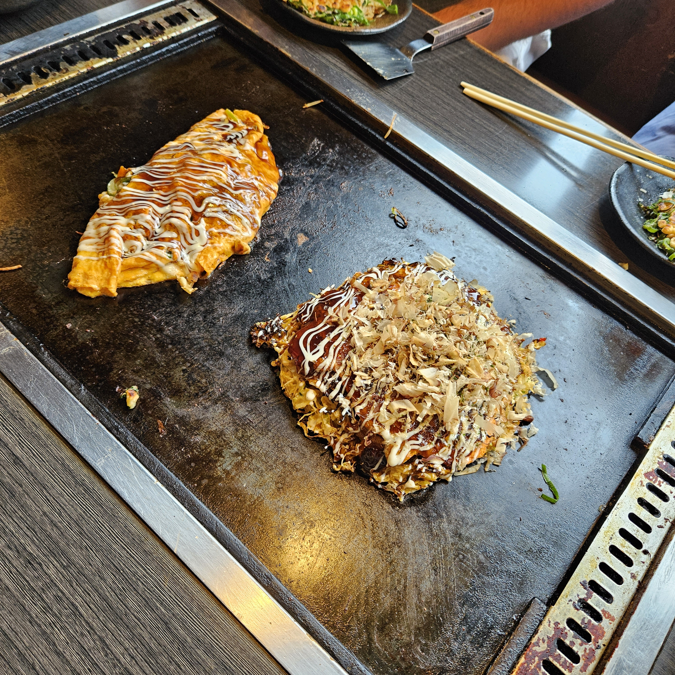
Food

Slide 16

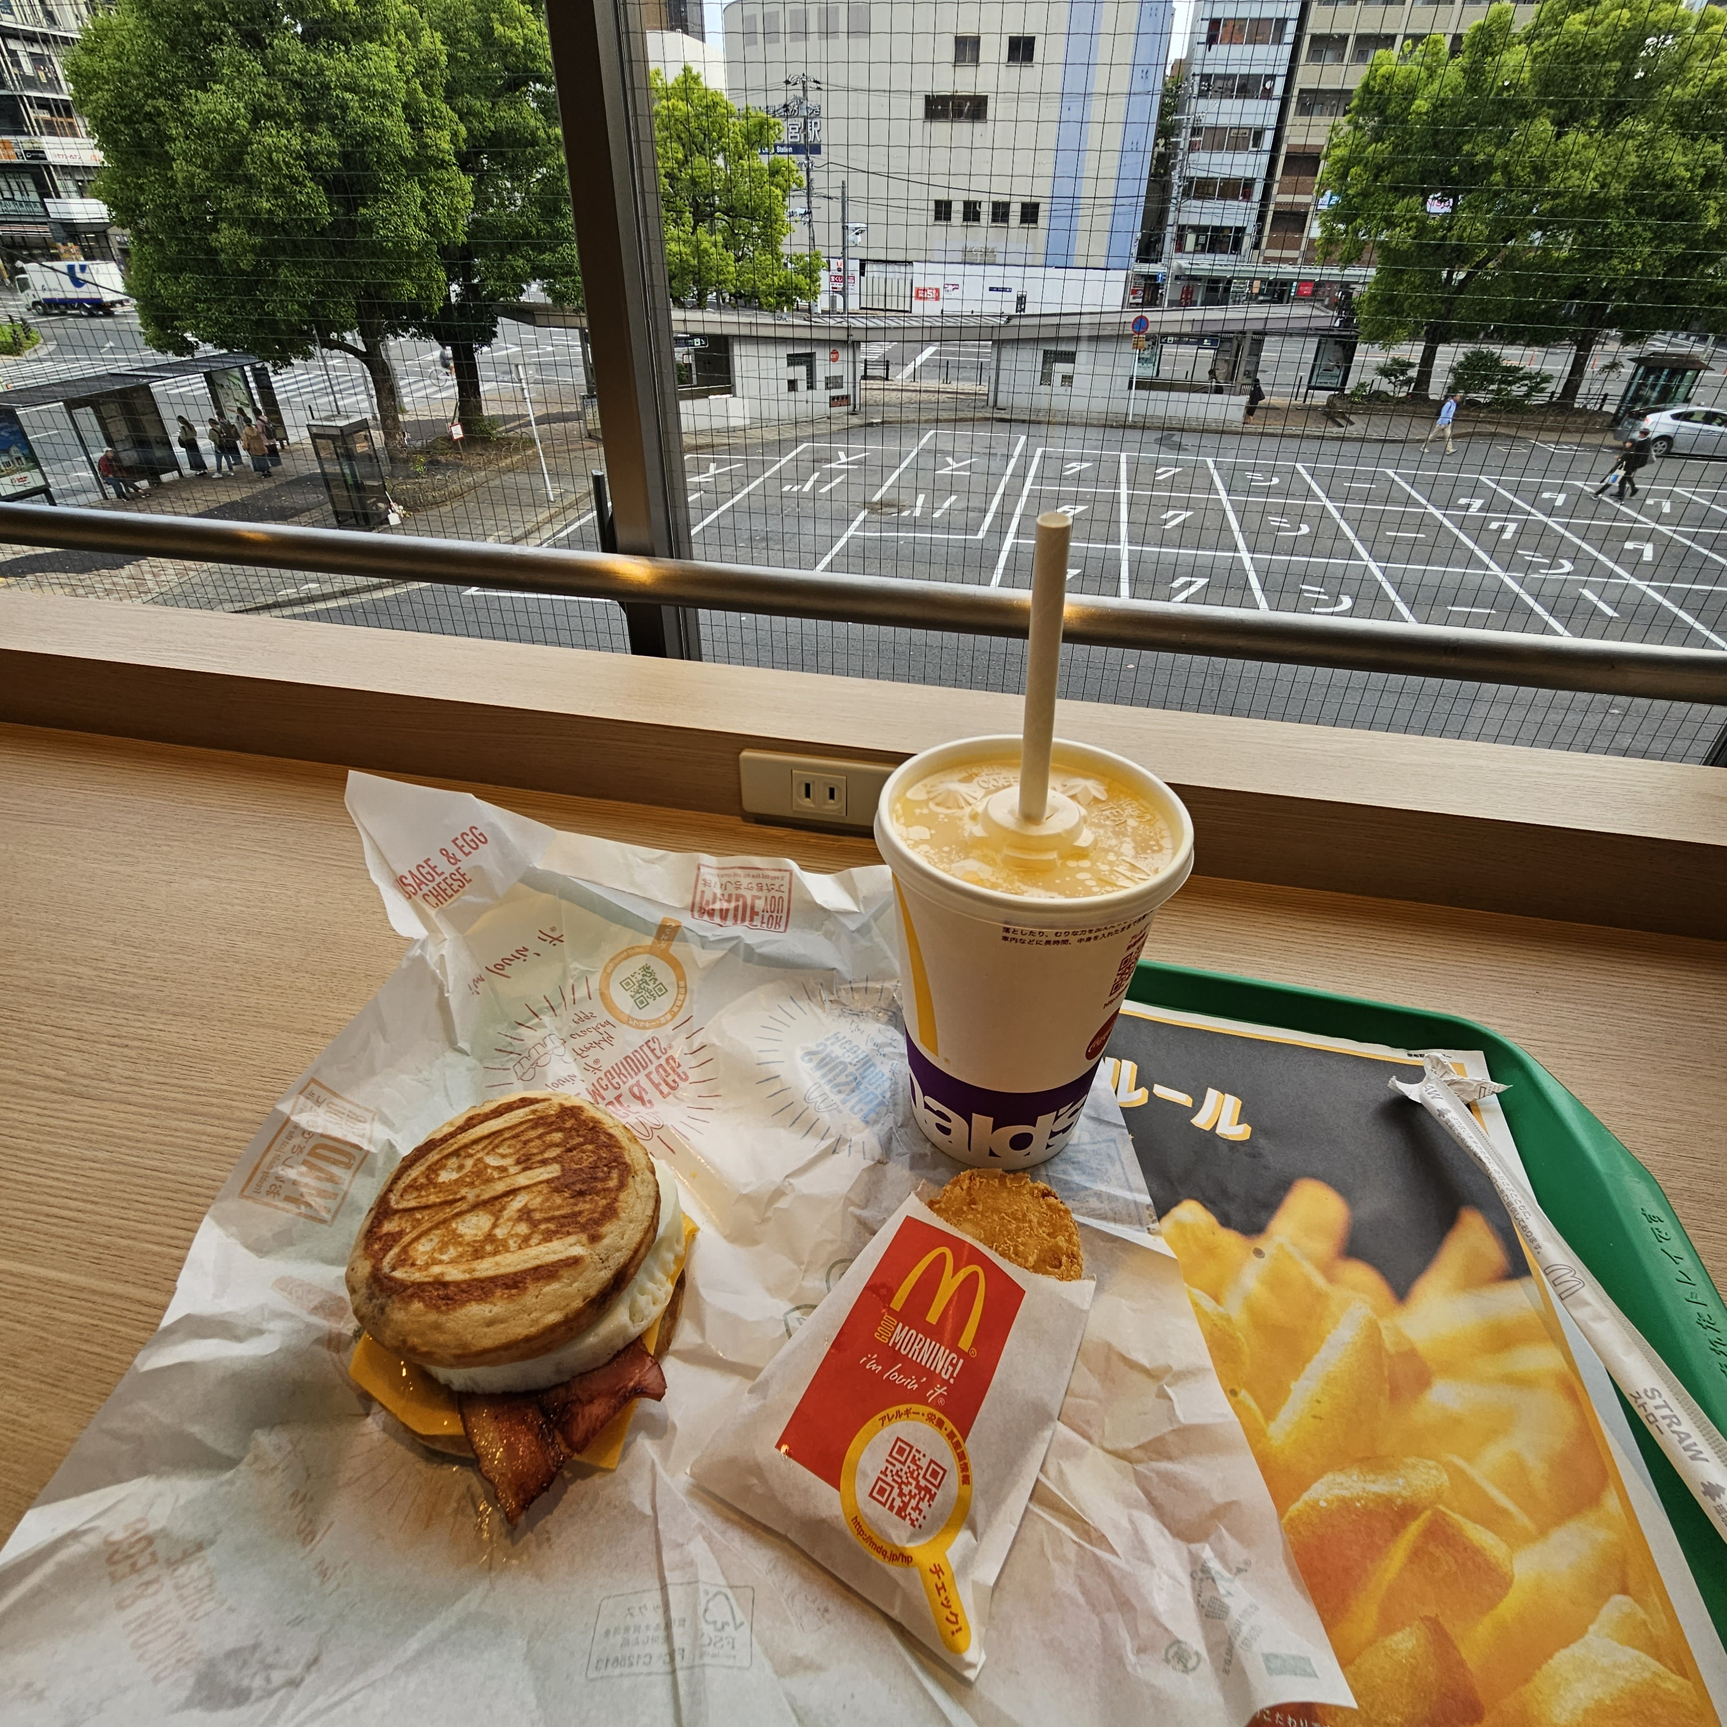
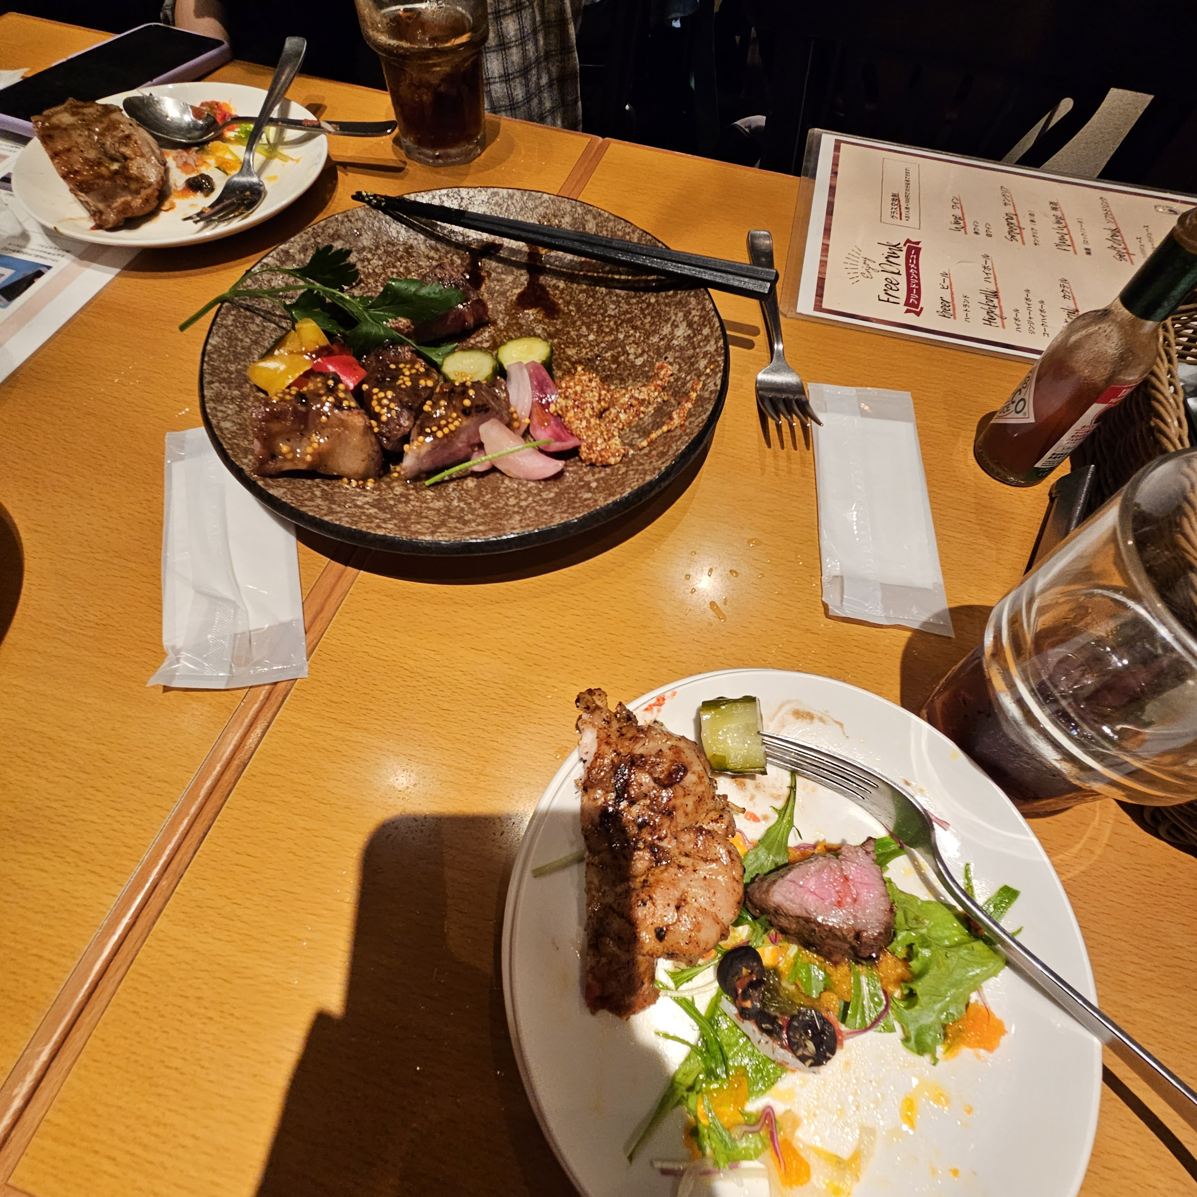
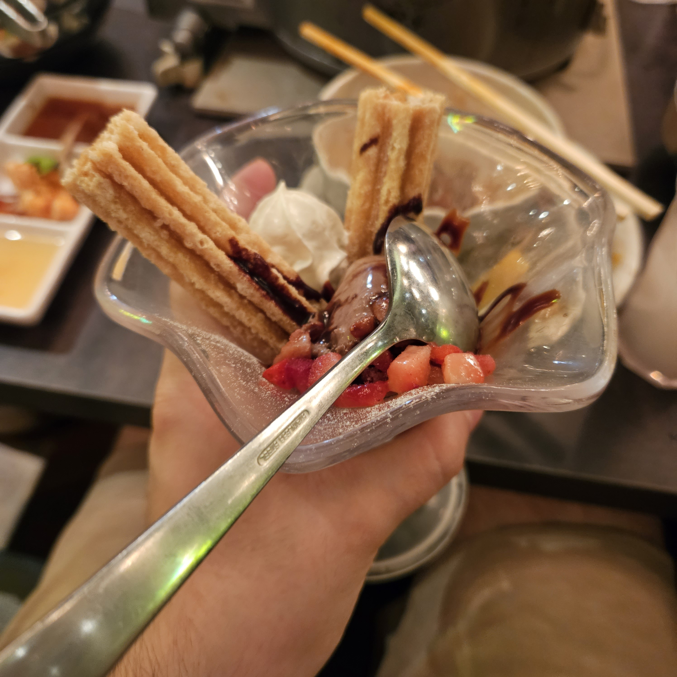
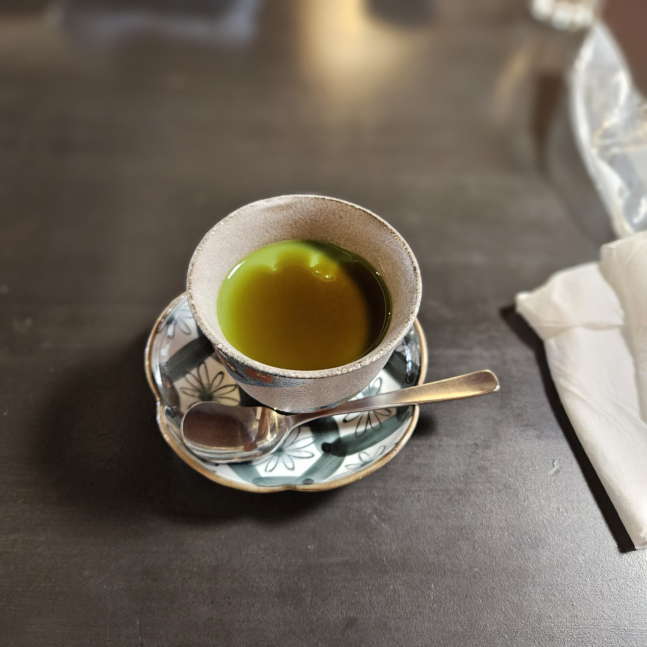
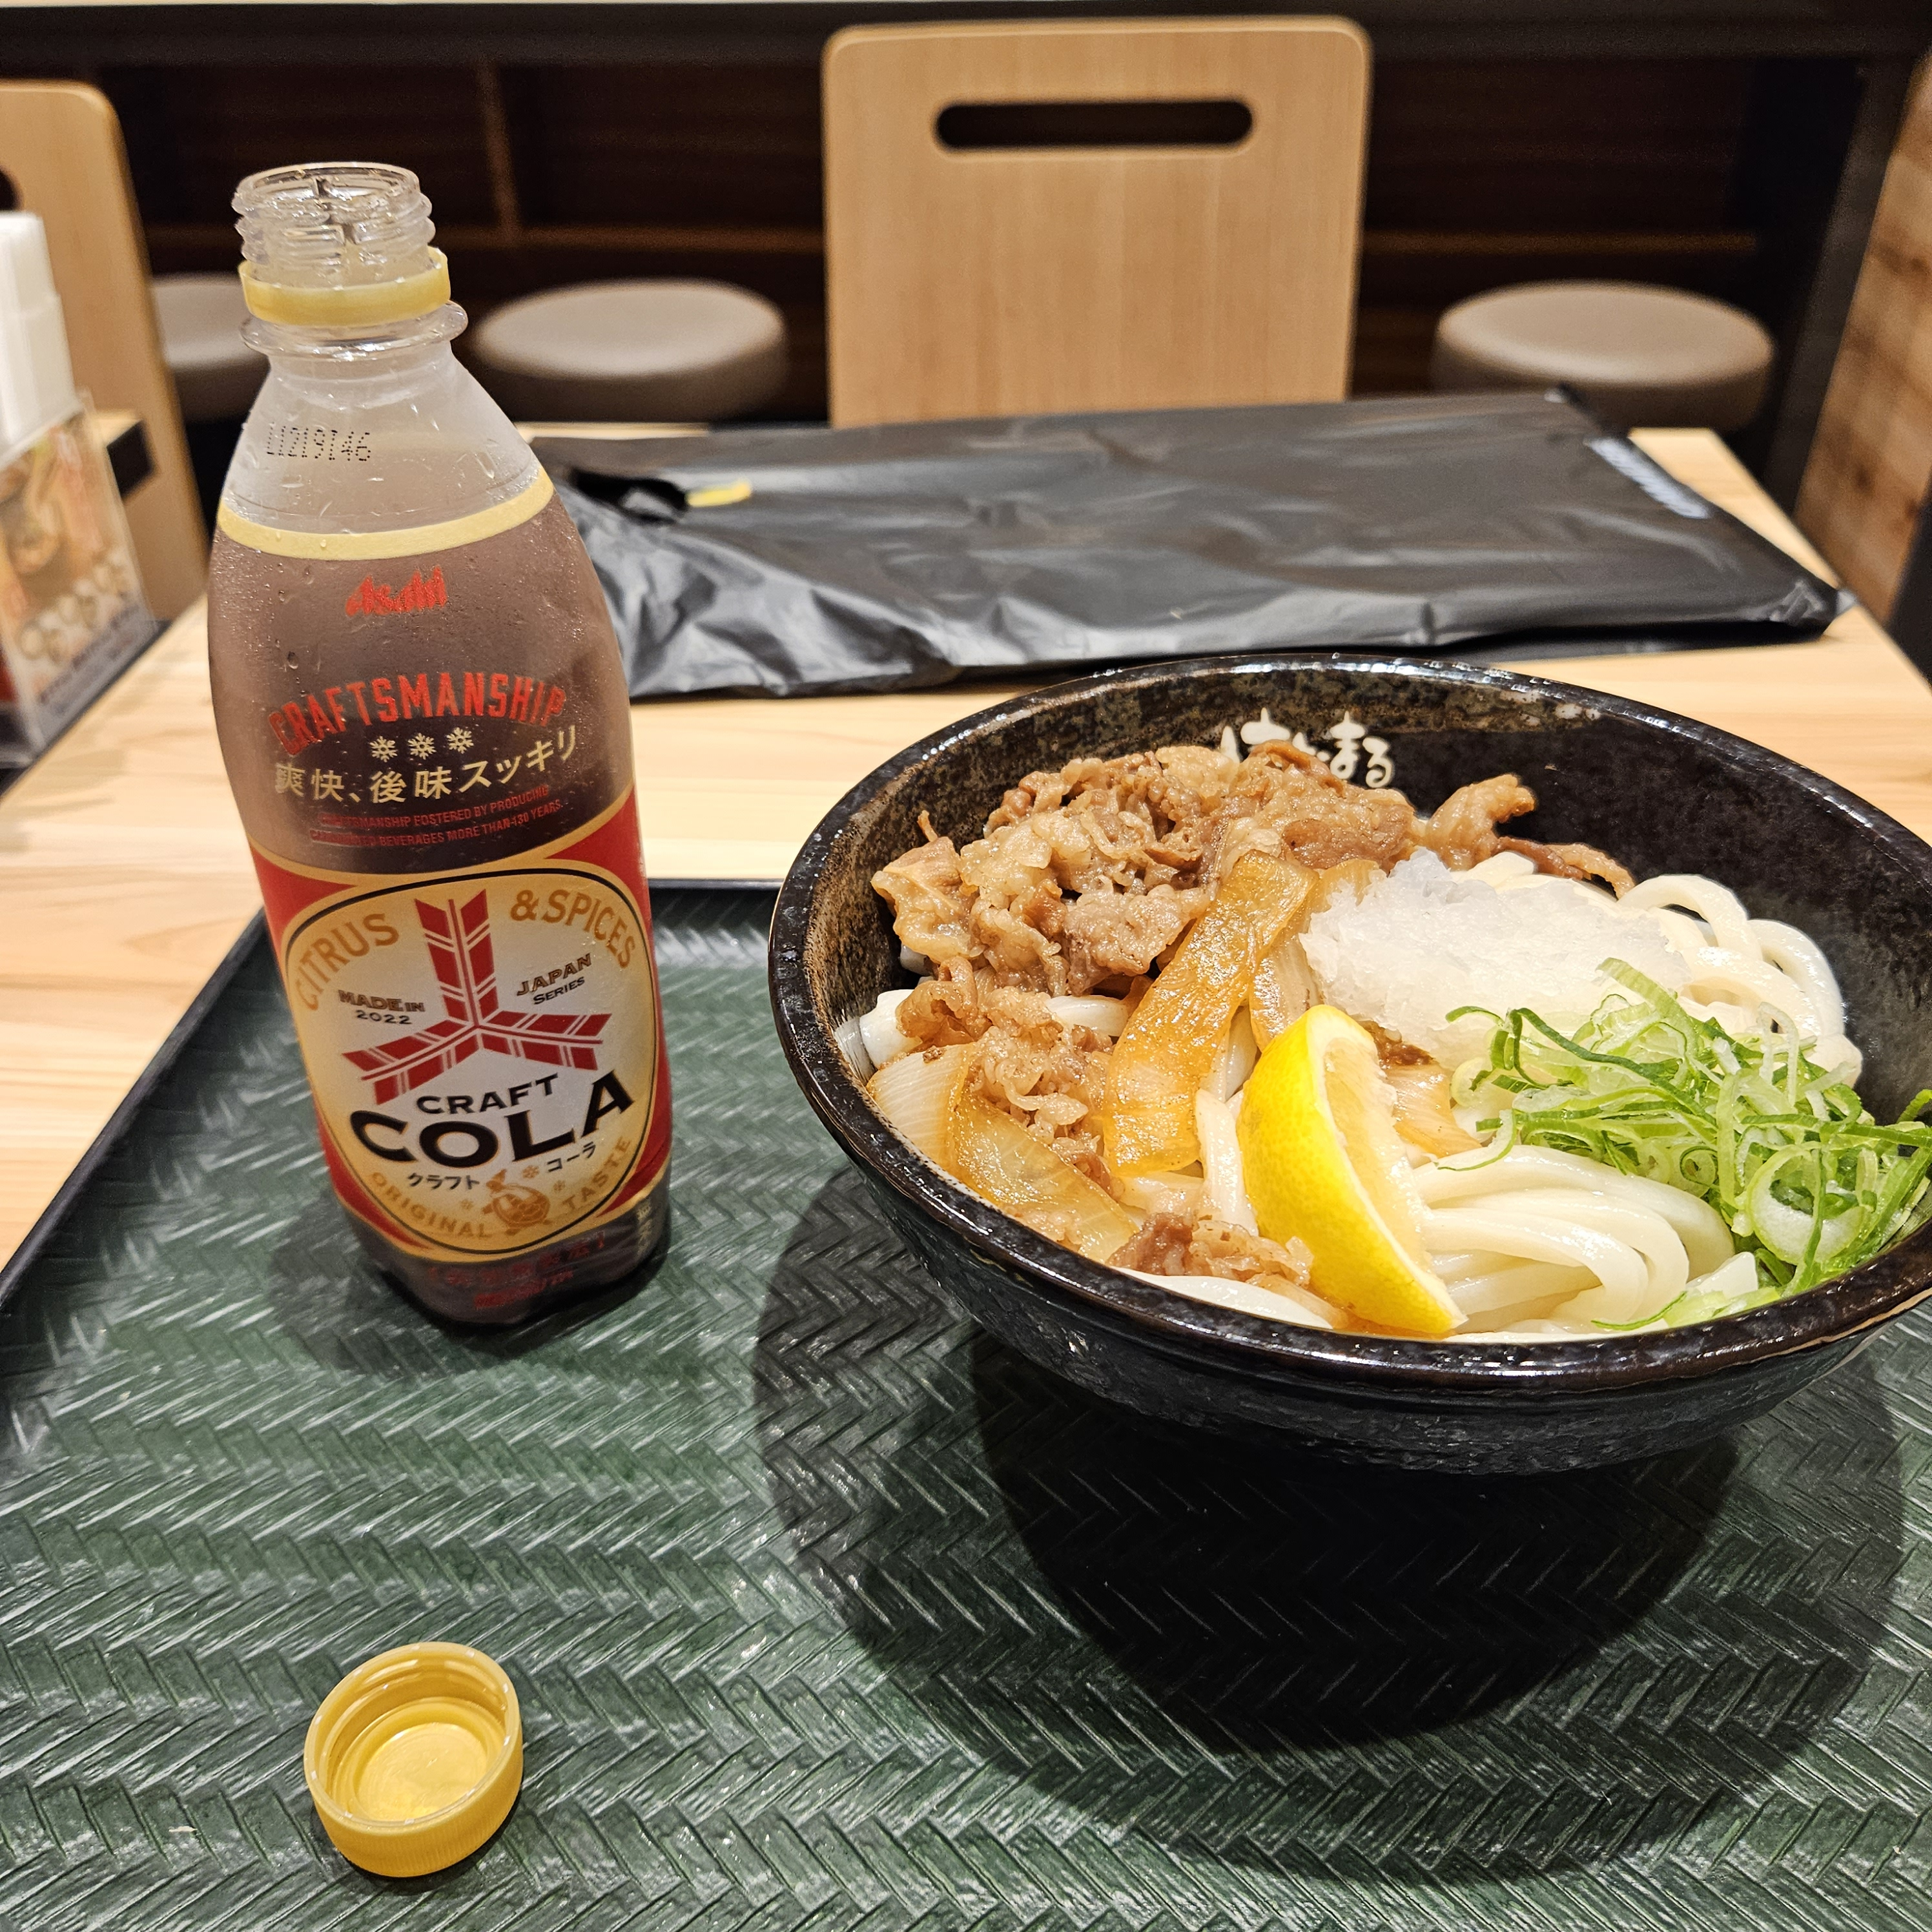
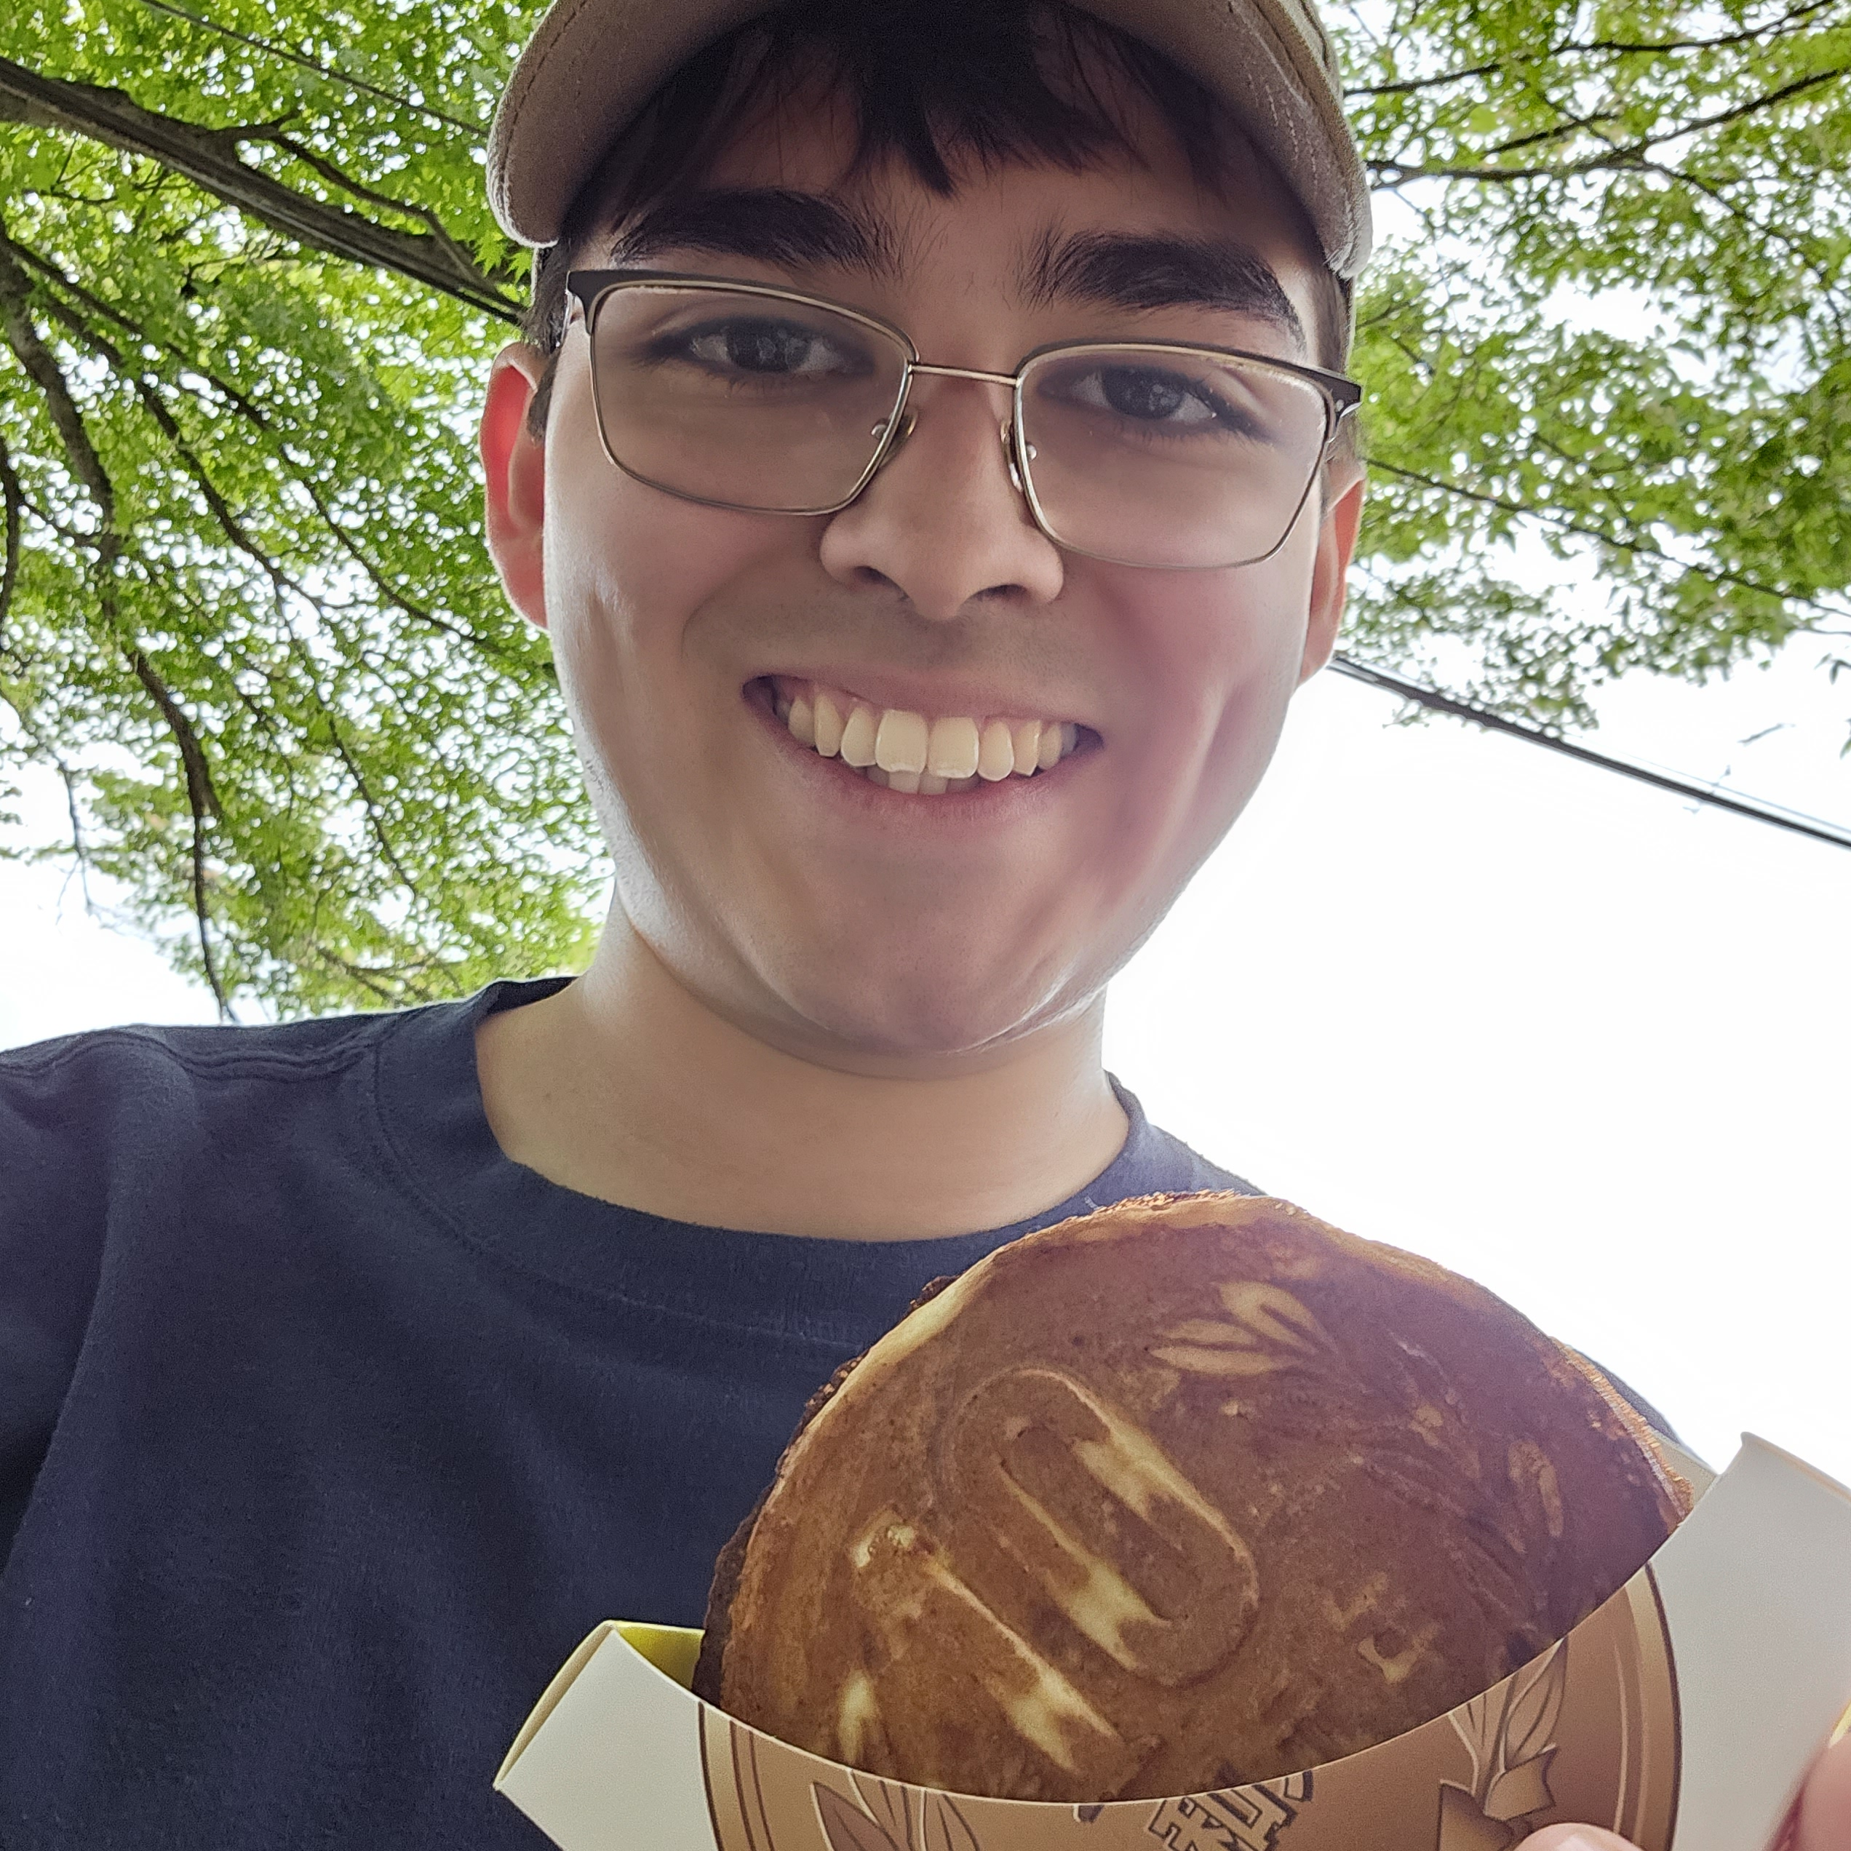
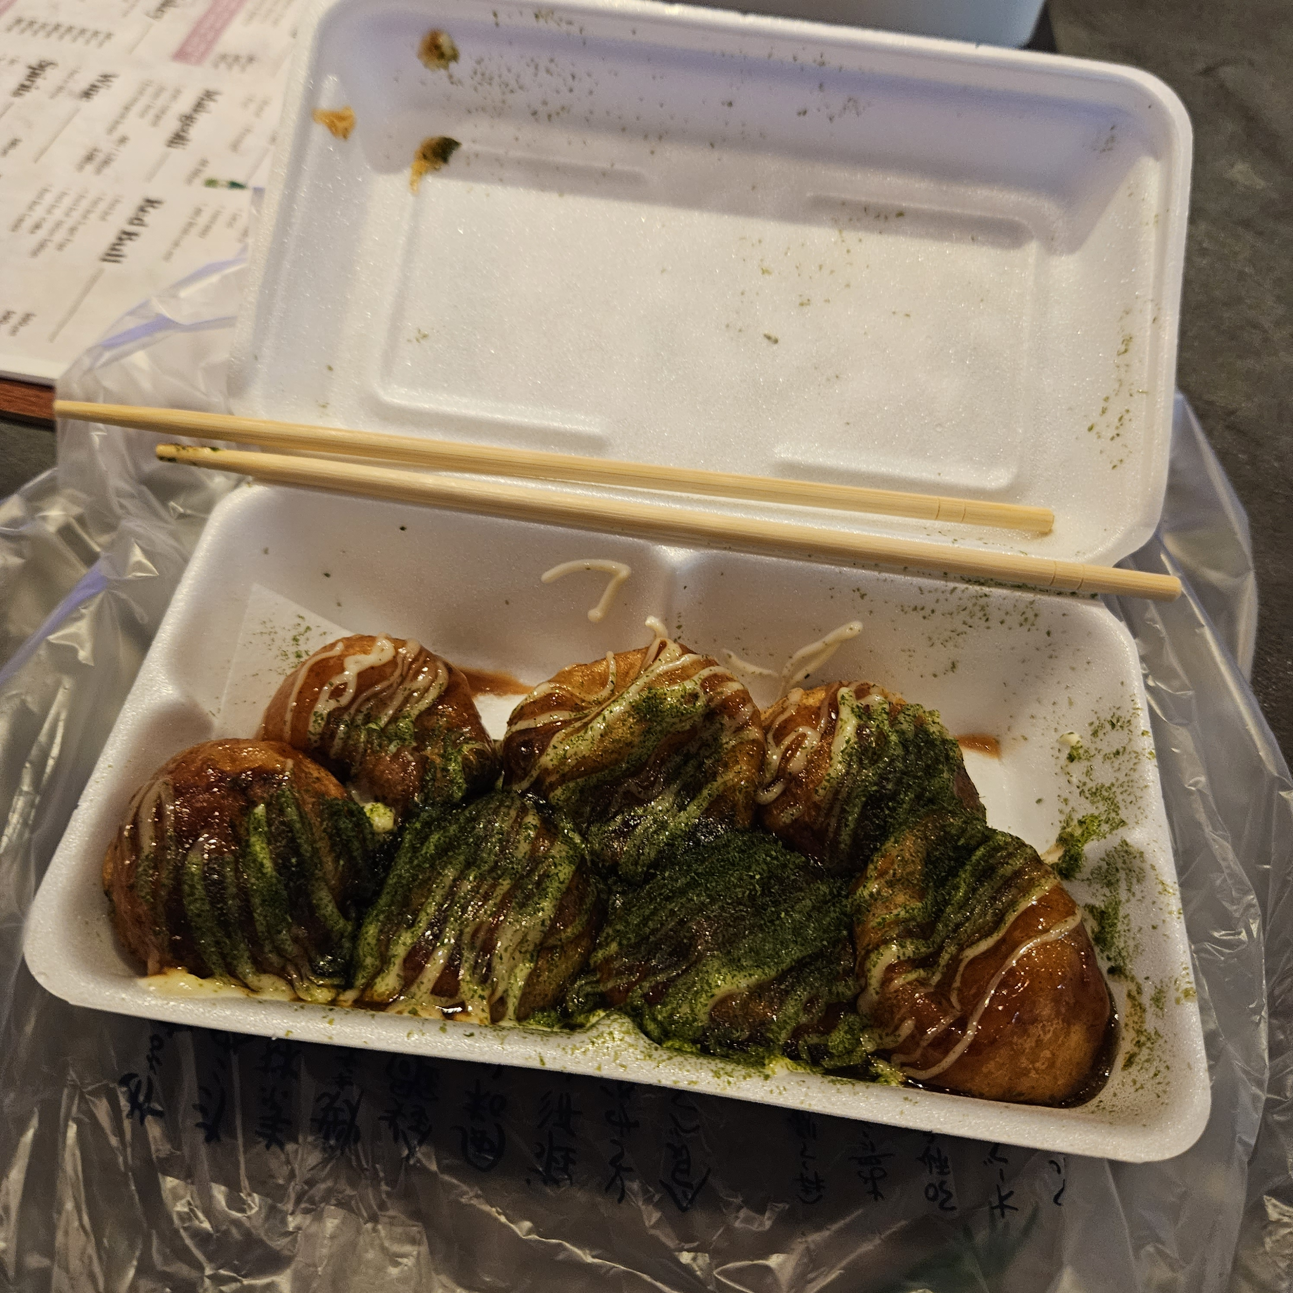
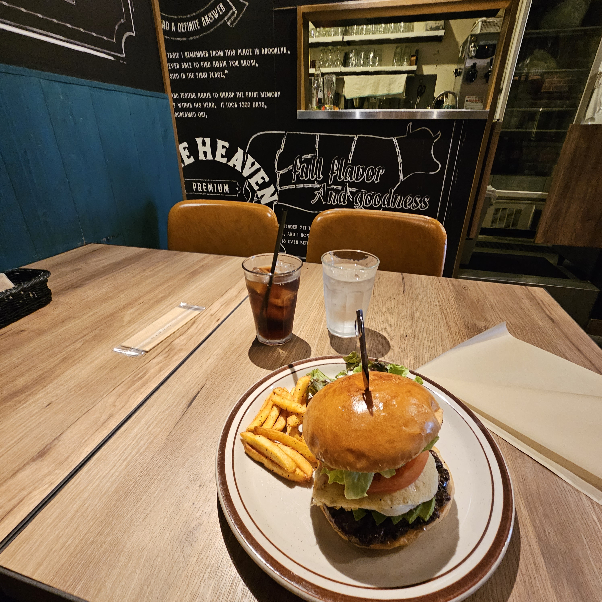
…More Food

Slide 17
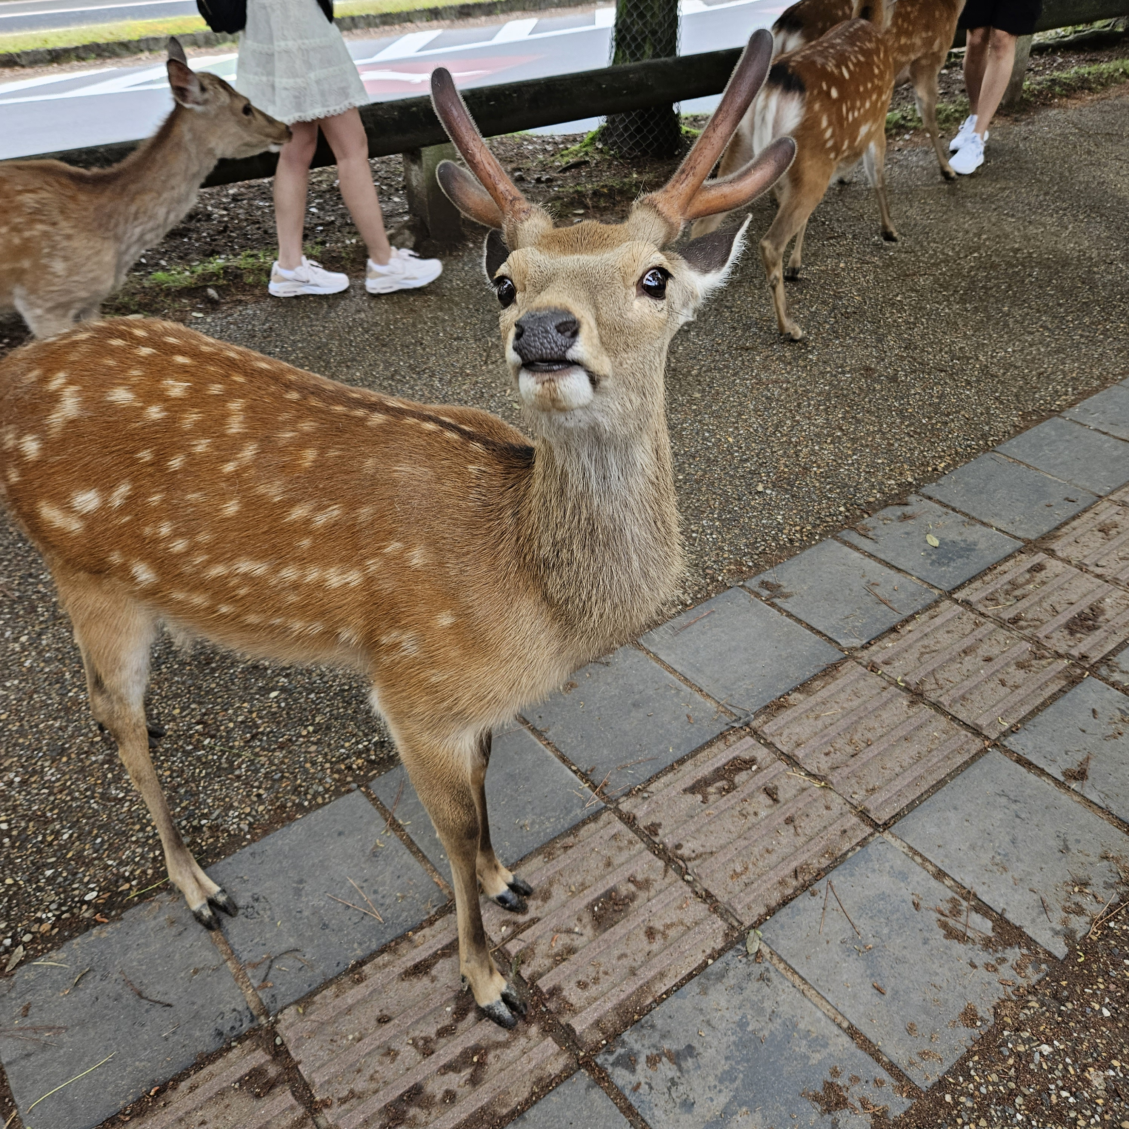

Nature

Slide 18
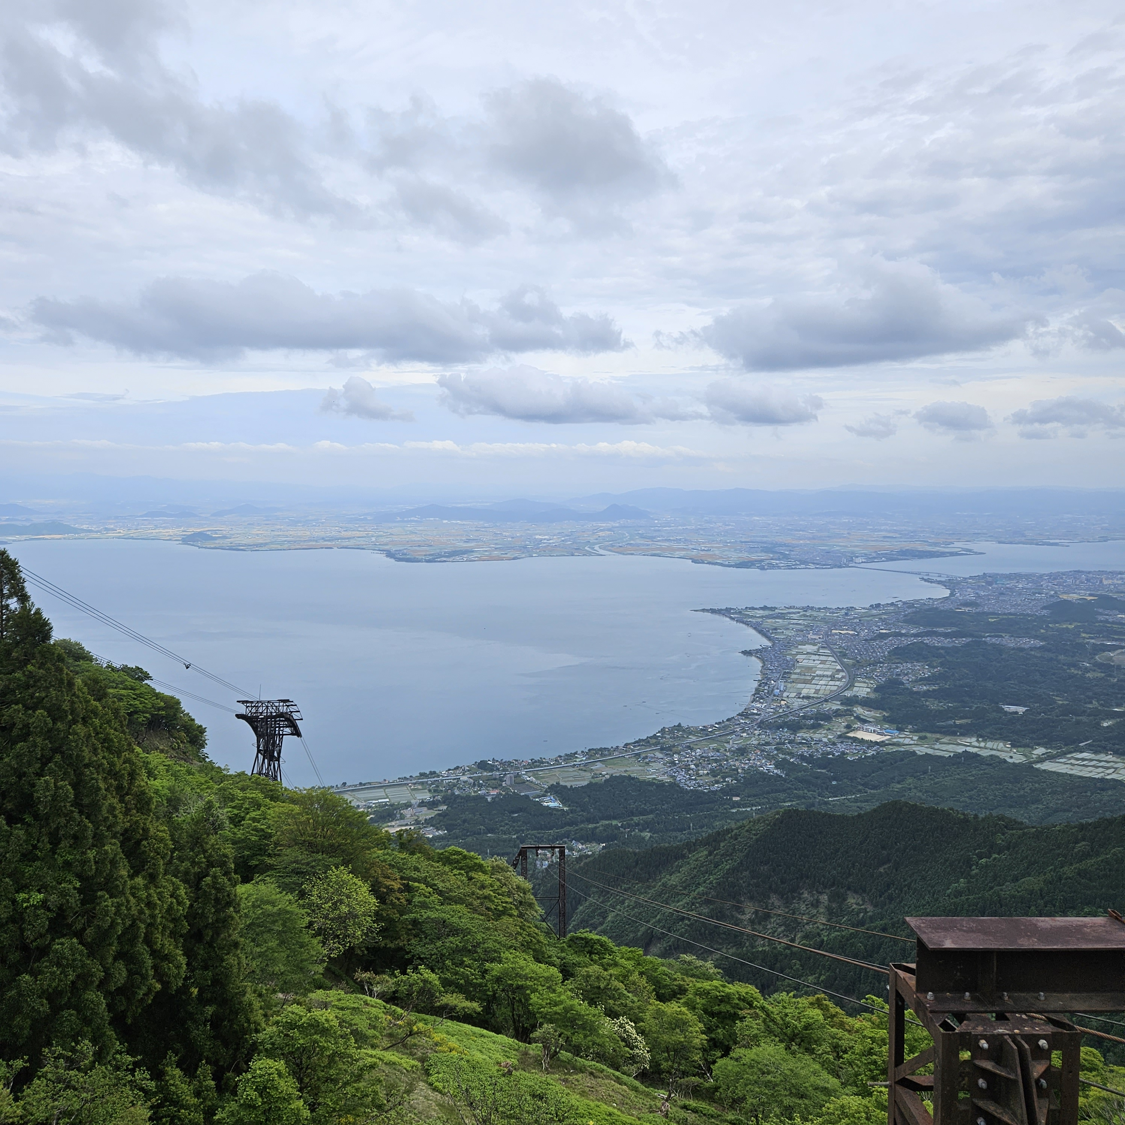


Slide 19

Studying Abroad
Impacted my future:
Opportunity of a lifetime

Slide 20
Other Scholarships
Fulbright us student Program
Boren scholarships and fellowships
Barry Goldwater Scholarship and Excellence in Education Program
…And many more!

Slide 21
Resources
https://www.irasutoya.com/
https://www.gilmanscholarship.org/

Slide 22
Thank you
Ian Caldwell
mirjam@contoso.com
www.contoso.com

